Slide 1
Quick Hands on Junit & Mockito
Ramesh Poludasu
Change HealthCare
04/23/2019

Slide 2
Agenda
Junit Overview
Junit Example with annotations
Mockito Overview
Mockito Annotations
Mockito Examples w.r.t SpringBoot

Slide 3
JUNIT
What?
Junit is a test framework working based on annotations.
It is an open source project hosted at Github.
Why?
To prevent LMFAO [looking manually for abnormal output] when scaling up to 50k, 250k tests with combination of inputs/outputs/flags/conditions.
Regression tests on enhancements prevent existing code breakage.

Slide 4
Junit
What should I know to work with Junit?
What to test (E.g. Class and method)?
What are the inputs to be provided?
What is the expected output for above inputs?
Compare the expected and actuals and give the result.

Slide 5
Junit
How do I do that?
> Example from eclipse
> com.chc.demo.Demo.java
> com.chc.demo.DemoTest.java
Assert Class
This has various methods to compare the actual and expected results.
Note: As of today, JUnit5 is the latest in the market.

Slide 6
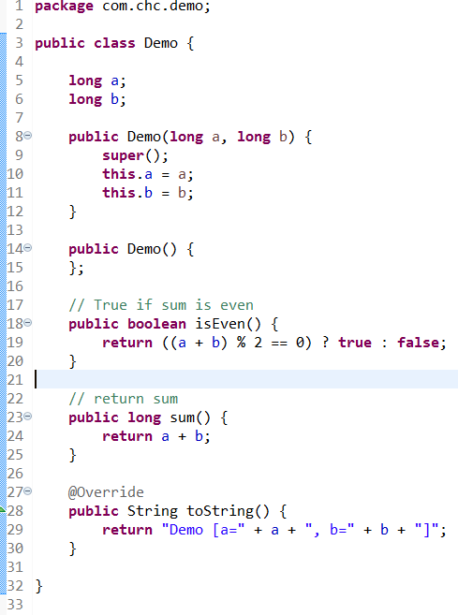
Sample code [ Demo.java ]

Slide 7
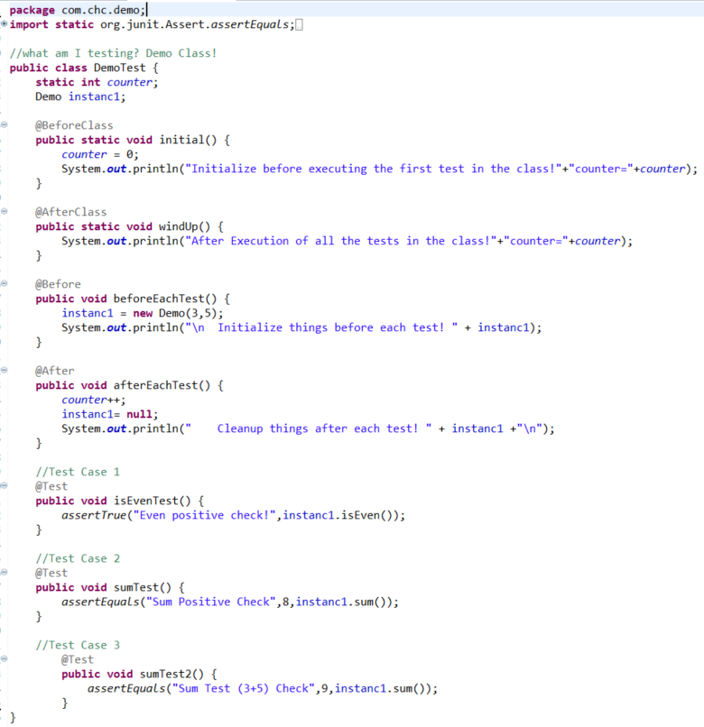
Junit Test Case Example

Slide 8
Mockito
What is it?
Mockito is an open source testing framework for Java released under the MIT License.
Why do we need it?
To generate/mock object of a certain class/interface and focus on actual class under test.
A mock object is a dummy implementation for an interface or a class in which you define the output of certain method calls.
Notes:
One core aspect in unit testing is the fact that you want to isolate your "class under test" from anything else in the world. In order to do that, you very often have to create "test doubles" that you provide to an object of your "class under test". You could create all those "test doubles" manually; or you use a mocking framework that generates object of a certain class for you using reflection techniques
A mock object is a dummy implementation for an interface or a class in which you define the output of certain method calls. Mock objects are configured to perform a certain behavior during a test. They typically record the interaction with the system and tests can validate that.

Slide 9
Dependencies
The spring-boot-starter-test “Starter” (in the test scope) contains the following provided libraries:
JUnit: The de-facto standard for unit testing Java applications.
Spring Test & Spring Boot Test: Utilities and integration test support for Spring Boot applications.
AssertJ: A fluent assertion library.
Hamcrest: A library of matcher objects (also known as constraints or predicates).
Mockito: A Java mocking framework.
JSONassert: An assertion library for JSON.
JsonPath: XPath for JSON.

Slide 10
Steps for implementation
Add dependencies to pom.xml
Create testcases using @RunWith, @SpringBootTest,@WebMvc, @MockBean etc.
Test cases to be developed at src/test/java and typical naming conventions as follows
Package: same as main/java/*
Class: ClassNameTest
Method: methodNameTest() or testMethodName[_desc]()
Notes:
<dependency>
<groupId>org.springframework.boot</groupId>
<artifactId>spring-boot-starter-test</artifactId>
<scope>test</scope>
</dependency>

Slide 11
Mockito important Annotations
@RunWith(SpringRunner.class) : Provides Spring TestContext Framework to standard JUnit tests and associated support classes and annotations.
@SpringBootTest : Tells Spring Boot to go and look for a main configuration class (one with @SpringBootApplication for instance), and use that to start a Spring application context.
@AutoConfigureMockMvc: Do not start the server at all, but test only the layer below that, where Spring handles the incoming HTTP request and hands it off to your controller
@WebMvcTest(value = MainController.class) : initialize only one web controller in the weblayer
Do not start the server in specific
Do not start the application context
Initialize the web layer for asked controller
MockMvc : Mock MVC offers a powerful way to quickly test MVC controllers without needing to start a full HTTP server
@MockBean: Create and inject a mock for any dependant class/interface.
@Test : Identify the below method as a test case.
@DataJpaTest: provides a way to test dao. By default, data JPA tests are transactional and roll back at the end of each test.
Notes:
@RunWith(SpringRunner.class)- alias for the SpringJUnit4ClassRunner. It is a custom extension of JUnit’s BlockJUnit4ClassRunner which provides functionality of the Spring TestContext Framework to standard JUnit tests by means of the TestContextManager and associated support classes and annotations.
@WebMvcTest : Annotation is used for Spring MVC tests. It disables full auto-configuration and instead apply only configuration relevant to MVC tests.
The WebMvcTest annotation auto-configure MockMvc instance as well.
@WebMvcTest(value = MainController.class) : Using MainController.class as parameter, we are asking to initialize only one web controller and you need to provide remaining dependencies required using Mock objects.

Slide 12
Mockito Examples
Controller Test
Service Test
Dao Test

Slide 13
Reference Links
https://docs.spring.io/spring-boot/docs/current/reference/html/boot-features-testing.html
https://howtodoinjava.com/spring-boot2/spring-boot-mockito-junit-example/
https://spring.io/guides/gs/testing-web/
https://grokonez.com/testing/datajpatest-with-spring-boot

Slide 14
Thank You

